Slide 1
LINEAR BLOCK CODES
Almost all block codes used today belong to a subset called linear block codes. A linear block code is a code in which the exclusive OR (addition modulo-2) of two valid codewords creates another valid codeword.
Topics discussed in this section:
Minimum Distance for Linear Block Codes Some Linear Block Codes

Slide 2

Note
In a linear block code, the exclusive OR (XOR) of any two valid codewords creates another valid codeword.

Slide 3
Table 10.1

Slide 4
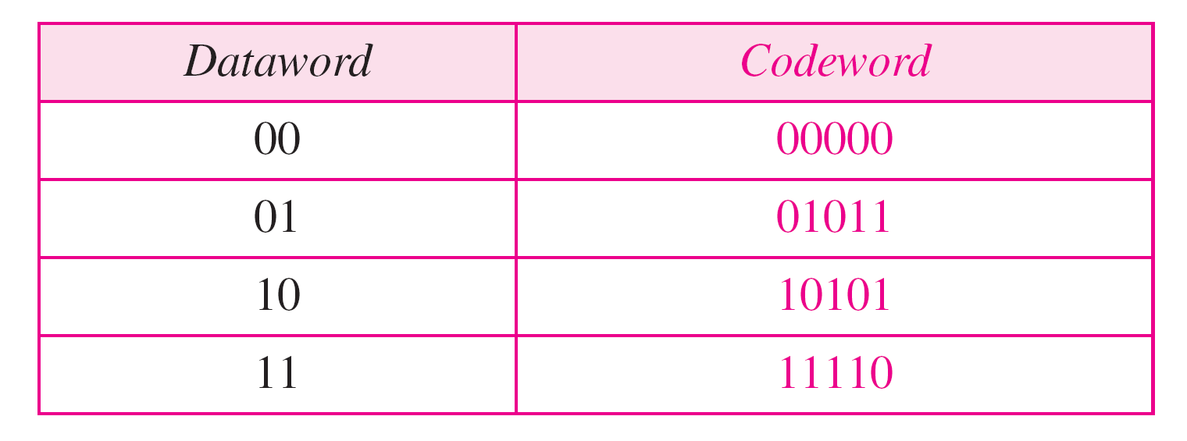
Table 10.2

Slide 5
Example 10.10
Let us see if the two codes we defined in Table 10.1 and Table 10.2 belong to the class of linear block codes.
1. The scheme in Table 10.1 is a linear block code because the result of XORing any codeword with any other codeword is a valid codeword. For example, the XORing of the second and third codewords creates the fourth one.
2. The scheme in Table 10.2 is also a linear block code. We can create all four codewords by XORing two other codewords.

Slide 6
Example 10.11
In our first code (Table 10.1), the numbers of 1s in the nonzero codewords are 2, 2, and 2. So the minimum Hamming distance is d_{min} = 2. In our second code (Table 10.2), the numbers of 1s in the nonzero codewords are 3, 3, and 4. So in this code we have d_{min} = 3.

Slide 7
Note
A simple parity-check code is a single-bit error-detecting code in which n = k + 1 with d_{min} = 2.

Slide 8
Table 10.3 Simple parity-check code C(5, 4)

Slide 9
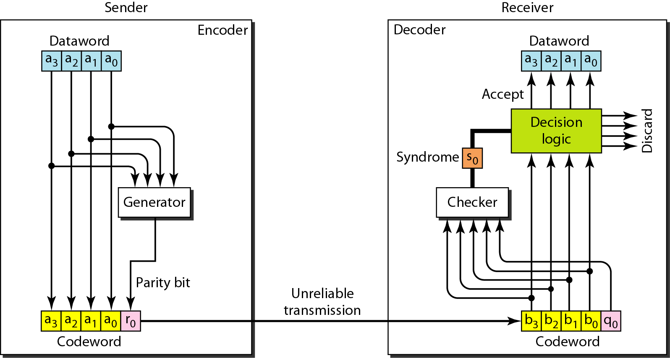
Figure 10.10 Encoder and decoder for simple parity-check code

Slide 10
Example 10.12
Let us look at some transmission scenarios. Assume the sender sends the dataword 1011. The codeword created from this dataword is 10111, which is sent to the receiver. We examine five cases:
1. No error occurs; the received codeword is 10111. The syndrome is 0. The dataword 1011 is created.
2. One single-bit error changes a₁ . The received codeword is 10011. The syndrome is 1. No dataword is created.
3. One single-bit error changes r₀ . The received codeword is 10110. The syndrome is 1. No dataword is created.

Slide 11
Example 10.12 (continued)
4. An error changes r₀ and a second error changes a₃ .
The received codeword is 00110. The syndrome is 0. The dataword 0011 is created at the receiver. Note that
here the dataword is wrongly created due to the
syndrome value.
5. Three bits—a₃, a₂, and a₁—are changed by errors. The received codeword is 01011. The syndrome is 1. The dataword is not created. This shows that the simple parity check, guaranteed to detect one single error, can also find any odd number of errors.

Slide 12
Note
A simple parity-check code can detect an odd number of errors.

Slide 13
Note
All Hamming codes discussed have d_{min} = 3.
The relationship between m and n in these codes is n = 2m − 1.

Slide 14
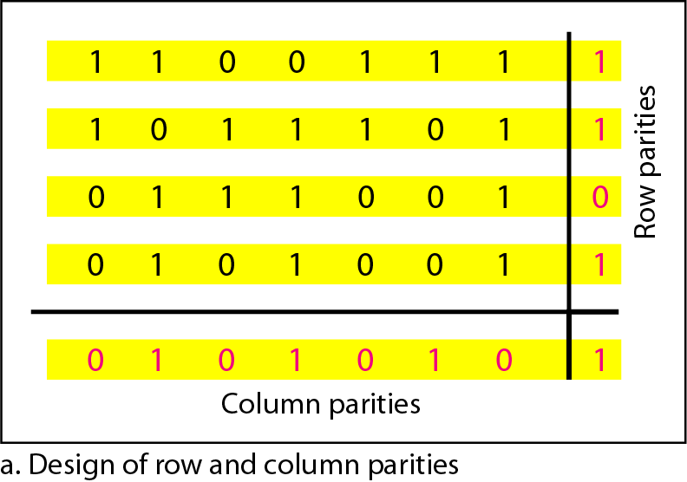
Figure 10.11 Two-dimensional parity-check code

Slide 15
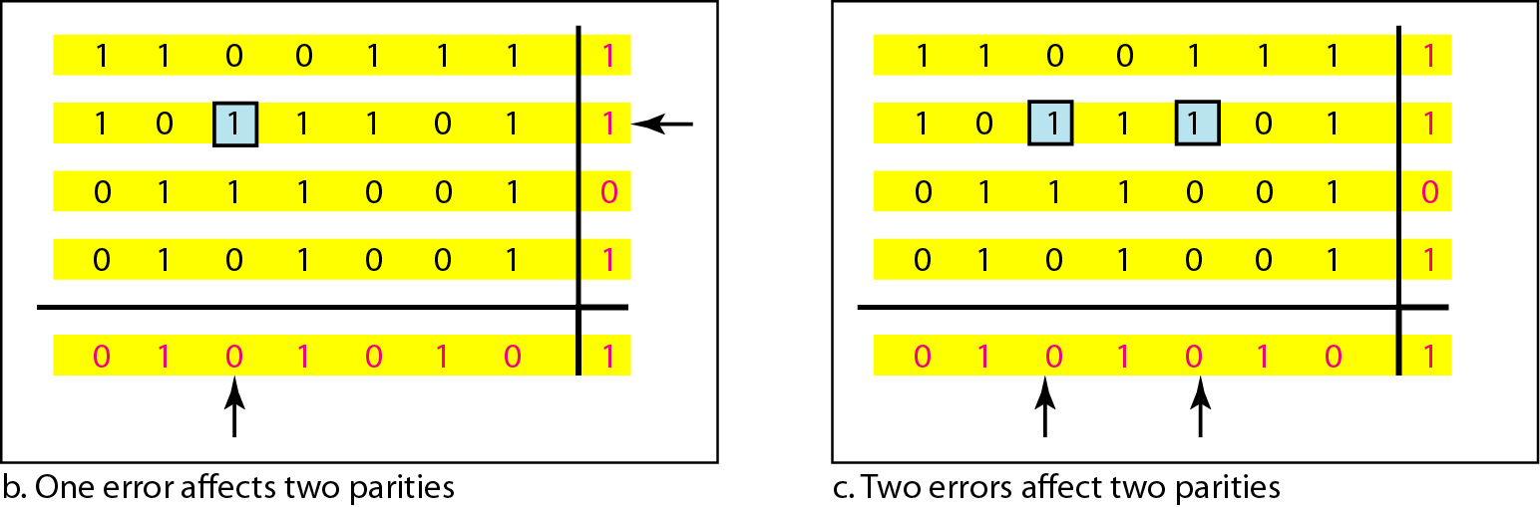
Figure 10.11 Two-dimensional parity-check code

Slide 16
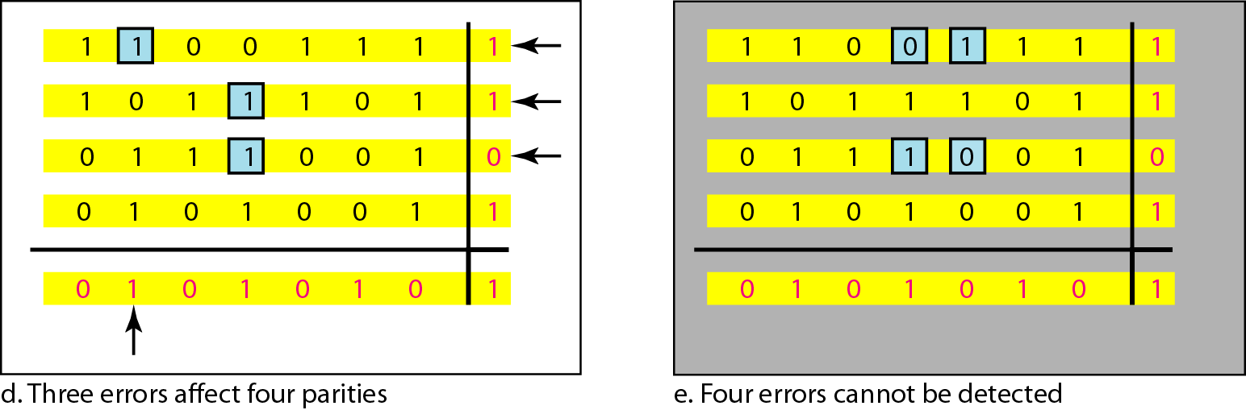
Figure 10.11 Two-dimensional parity-check code

Slide 17
Table 10.4 Hamming code C(7, 4)

Slide 18
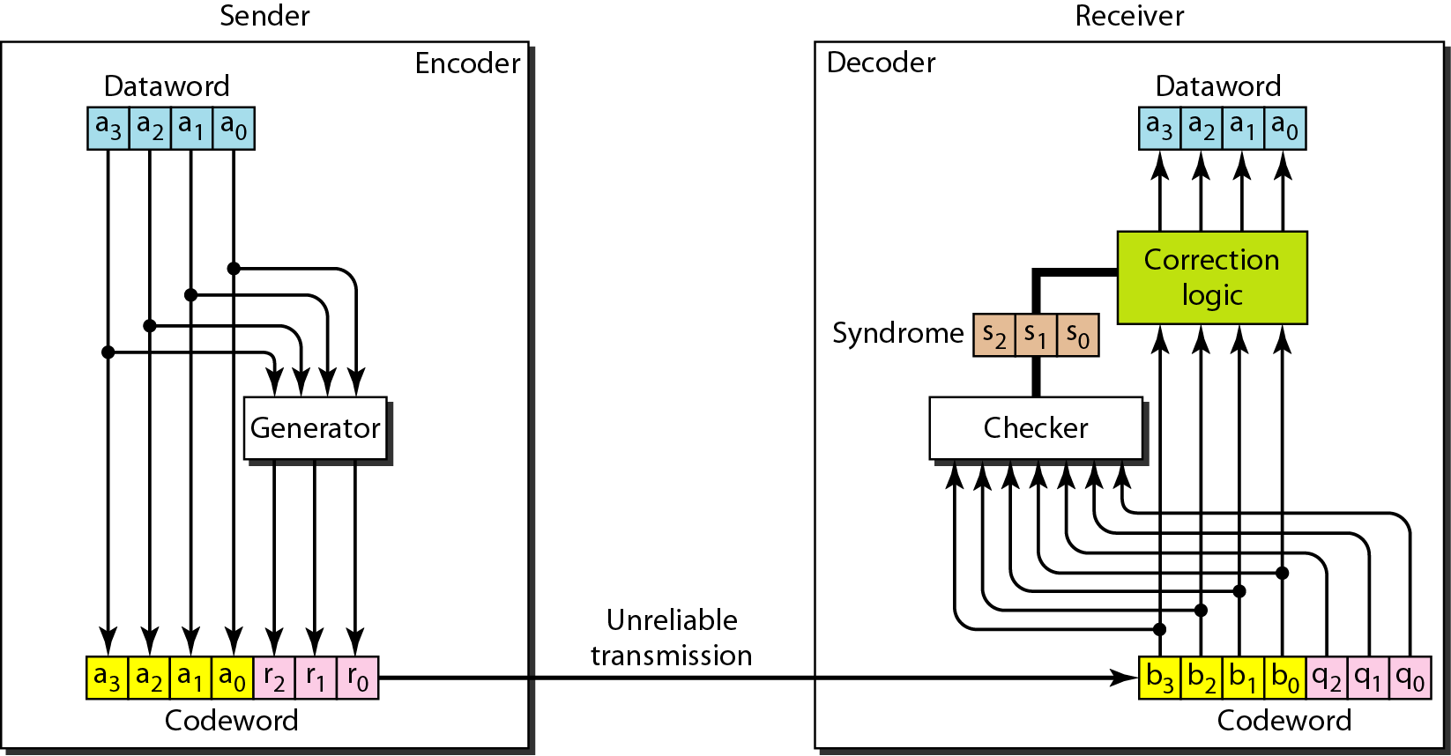
Figure 10.12 The structure of the encoder and decoder for a Hamming code

Slide 19
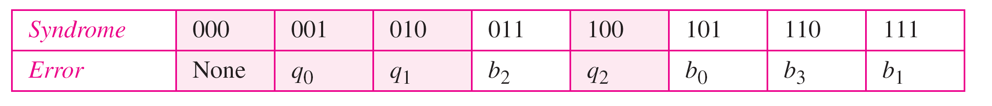
Table 10.5 Logical decision made by the correction logic analyzer

Slide 20
Example 10.13
Let us trace the path of three datawords from the sender to the destination:
1. The dataword 0100 becomes the codeword 0100011. The codeword 0100011 is received. The syndrome is 000, the final dataword is 0100.
2. The dataword 0111 becomes the codeword 0111001. The syndrome is 011. After flipping b₂ (changing the 1 to 0), the final dataword is 0111.
3. The dataword 1101 becomes the codeword 1101000. The syndrome is 101. After flipping b₀, we get 0000, the wrong dataword. This shows that our code cannot correct two errors.

Slide 21
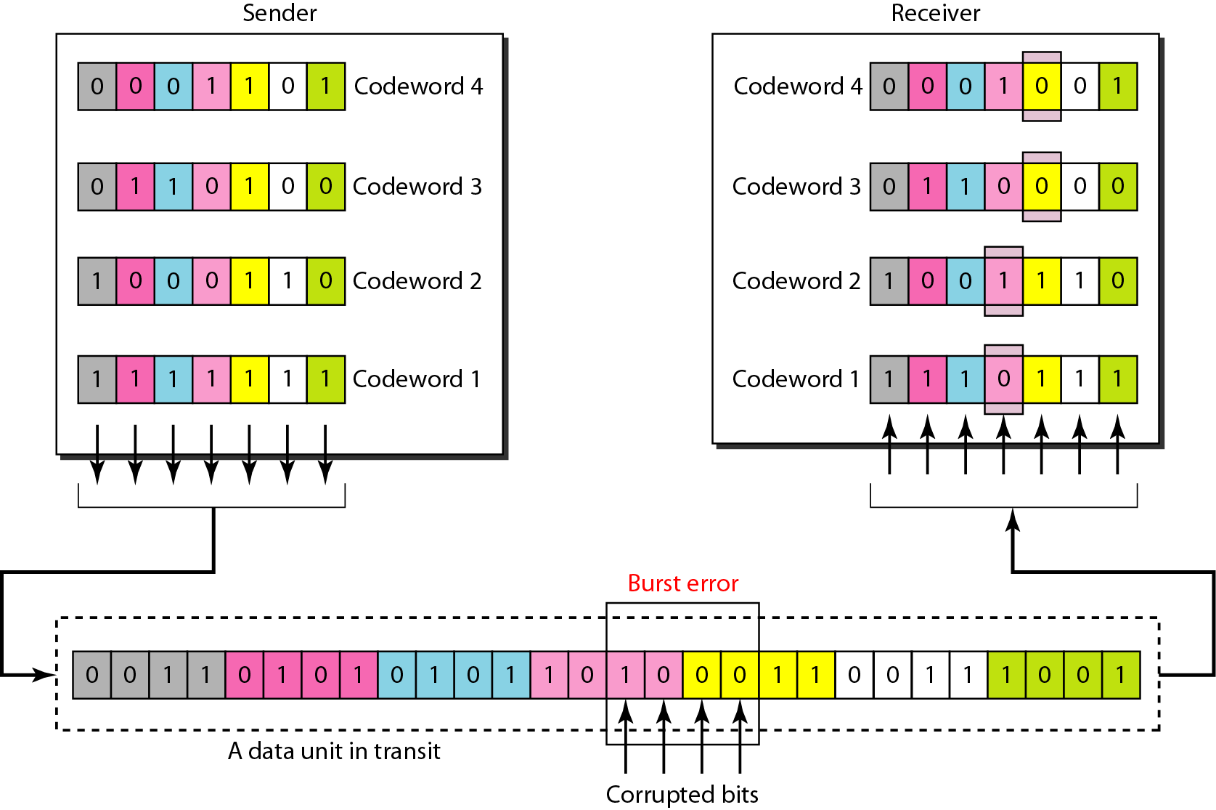
Figure 10.13 Burst error correction using Hamming code

Slide 22

References:
Chapter 10
Error Detection and Correction
Copyright © The McGraw-Hill Companies, Inc. Permission required for reproduction or display.

